Slide 1
H.I.P. Workplace Initiative
An interdisciplinary community to conduct and share research that fosters health, inclusion and productivity in the future workplace

Slide 2
Mission
To foster
Healthy, Inclusive,and Productive workplaces
via integrated interdisciplinary collaborations.
Healthy
Productive
Inclusive

Slide 3
H.I.P. Values
Processes
Interdisciplinary collaborations
Institutional mentoring
Industry partnerships
Outcomes
Innovative ideas and products
Increasing knowledge on health, inclusion & productivity
Impactful research to workplace and society

Slide 4
H.I.P. Goals
& Objectives
Inter-disciplinary Research
Industry Engagement
Community
Building
Design impactful science
Expand funding portfolio
Learn workplace current issues
Share knowledge & innovation
Mentoring and support
Networking & Connecting

Slide 5
Consulting HIP Faculty

Slide 6
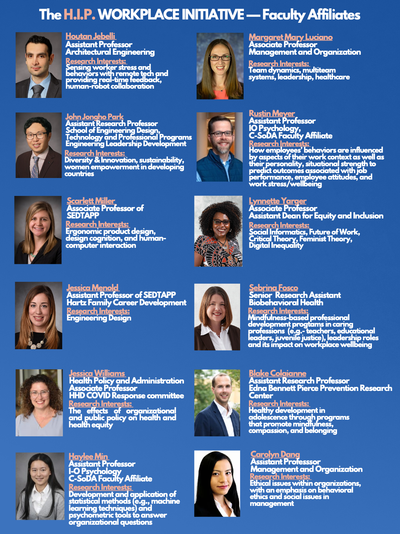
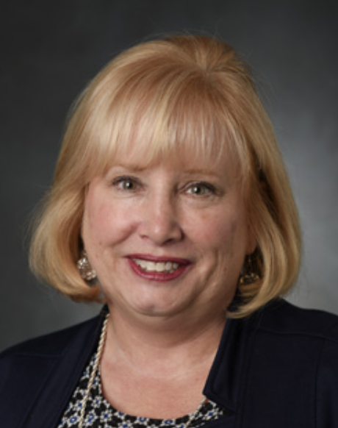
Affiliate HIP Faculty
Robin Tate
Director of Professional Programs Outreach Assistant Teaching Professor
Research Interests:
Adult learning and efficacy, work climate and microcredentialing to support learning; caregiving and military; psychometrics

Slide 7
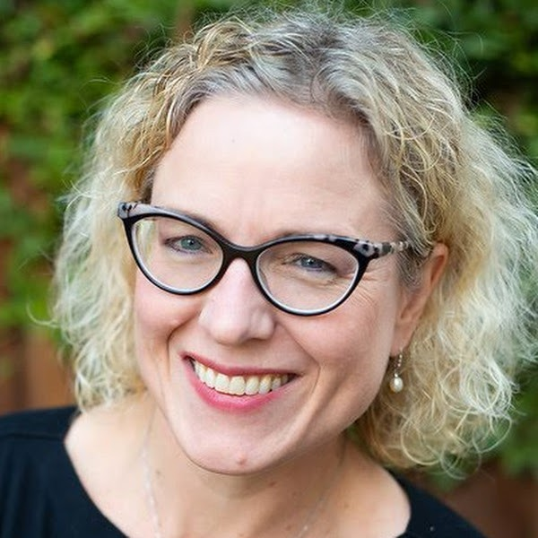
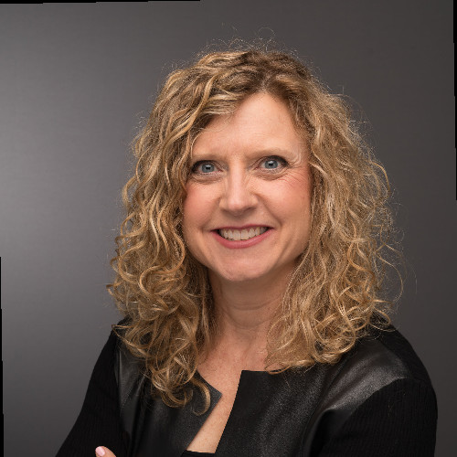
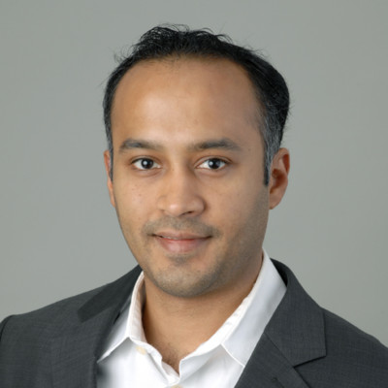
HIP Industry Advisory Panel
Industry Advisory Panel
Praveen Atreya
Vice President, Technology and Product Development
Jennifer Kurkoski
Director,
People Analytics
Suzy Lyon
Senior Vice President,
Human Resources

Slide 8
See HIP Website for Impactful Research
https://hipworkplace.la.psu.edu/new-hip-research/
Share Science

Slide 9
Supporting creativity and retention in diverse teams
Work schedules/flexibility on retention
Healthy
Productive
Inclusive
GRAND CHALLENGE
With hybrid/remote work, what are
short-term and long-term costs/gains
for well-being & productivity
for diversity & retention
for career growth & creativity
Inform Science
Psychological Safety climate and robots/AI in teams

Slide 10
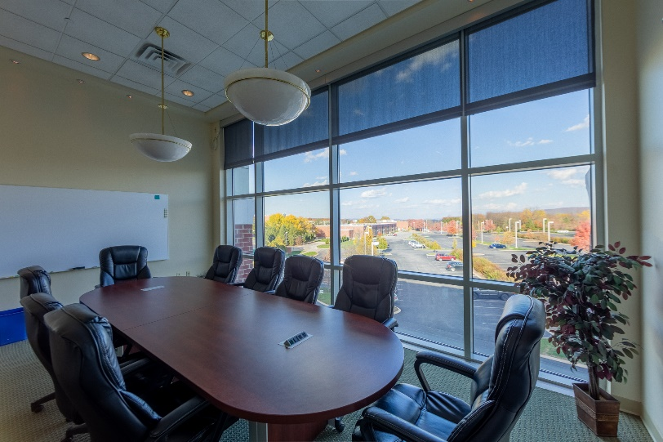
Plans for Fall 2022
Workshop on Health/Inclusion/Productivity
Industry practices
Science evidence
Small group research proposals
Industry feedback
Science funding
Build & broaden connections and resources
Grant seeking
New research development
Digital Districts in 5G
Notes:
New asst Vice Provost Amy Elliott named assistant vice provost for data management and operations https://www.psu.edu/news/faculty-and-staff/story/amy-elliott-named-assistant-vice-provost-data-management-and-operations/?utm_audience=Combined&utm_source=newswire&utm_medium=email&utm_campaign=Penn%20State%20Today&utm_content=02-20-2022-21-04&utm_term=Administration%20-%201

