Slide 1
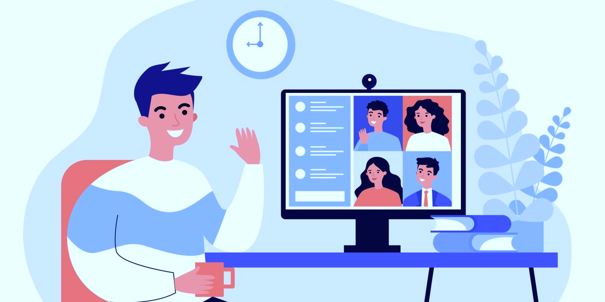
Videoconference or Zoom Fatigue: How Reduce it?
Key Takeaways:
Don’t schedule meetings back-to-back or late afternoon
Allow muting rather than “Mic-on” policies
Set clear group norms for mics & camera requirements
Provide opportunities for breaks during meetings
Encourage participation of all members
How do we know? The research behind it:
Scholars surveyed workers from a variety of industries who were newly working remotely due to the COVID-19 pandemic. Over 5 workdays, 55 workers reported on the characteristics of their meetings and their experience of fatigue. These workers answered open-ended questions about their experiences.¹
Videoconferencing Fatigue: the phenomenon of feeling tired and exhausted attributed to a videoconference. This term was popularized during the COVID-19 pandemic when much of the workforce moved to a virtual setting.
WHAT?
Fatigue occurs more often:
Fatigue occurs less often:
When given
breaks during meetings
When muting microphone more frequently
Nittany Notes:
Muting the microphone was associated with less fatigue than mic-off, but it’s possible that this is due to those who are presenting or leading the meeting have their mic-on and are more fatigued.
Immediately following a meeting, especially later in the workday
WHEN?
Higher
group
belongingness
When group norms are established
Citation: [1] Bennett, A. A., Campion, E. D., Keeler, K. R., & Keener, S. K. (2021). Videoconference fatigue? Exploring changes in fatigue after videoconference meetings during COVID-19. Journal of Applied Psychology, 106(3), 330–344. https://doi.org/10.1037/apl0000906

