Slide 1
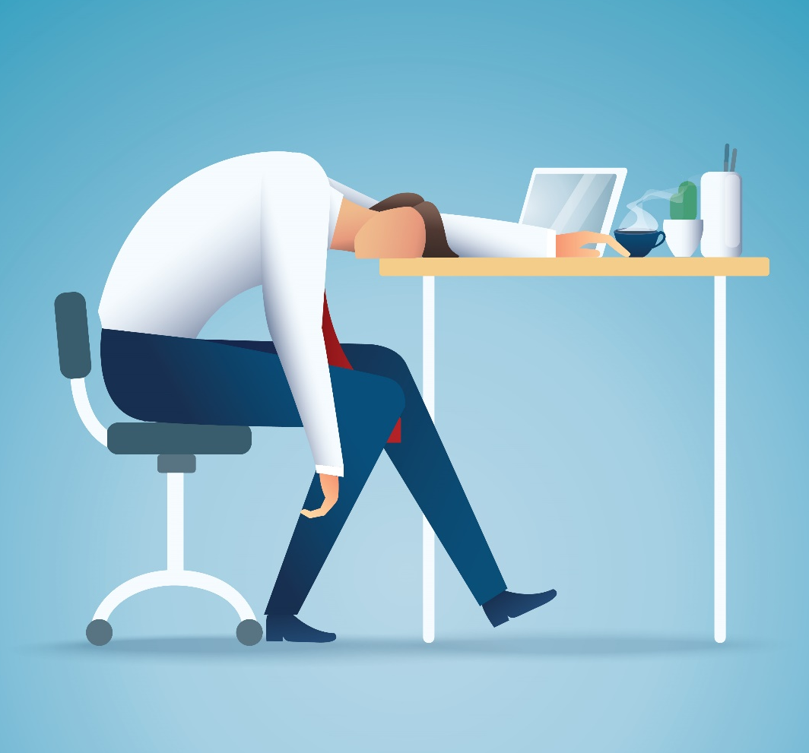
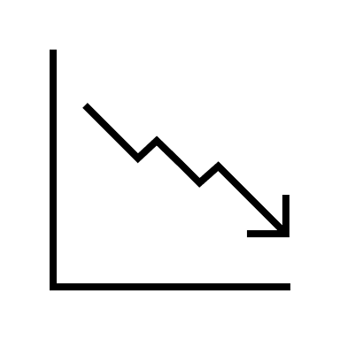
Coping with Zoom Fatigue: Should you require people to be “on camera” during virtual meetings ?
Key Takeaways:
Zoom fatigue is increased with “Camera on” policies
Fatigue from being “on camera” impairs meeting engagement and voice
These costs were greater for women and low status employees
Zoom Fatigue (or Virtual Meeting Fatigue) become critical to understand when the COVID-19 pandemic resulted in much of the global workforce working remotely or virtually.
WHAT?
Study found that employees report more fatigue when required to have their cameras on than off. Cameras were particularly fatiguing for women and newer employees, who may have to engage in more self-presentational effort
WHO?
How do we know this? This information is from a study that used about 100 workers from one company who typically work remotely, and were assigned to keep their cameras on or off during video calls across different work days. Researchers compared the workers’ ratings of fatigue & engagement for “camera on” and “camera off” days.
The Zoom fatigue from being “on camera” resulted in feeling less engaged and not voicing their opinions during meetings. However, objective performance metrics were not measured.
SO?
Citation: Shockley, K. M., Gabriel, A. S., Robertson, D., Rosen, C. C., Chawla, N., Ganster, M. L., Ezerins, M.E. (2021). The fatiguing effects of camera use in virtual meetings: A within-person field experiment. Journal of Applied Psychology, 106(8), 1137.

